Slide 1
CS4100: Computer Architecture Course Overview
Prof. Chung-Ta King
Department of Computer Science
National Tsing Hua University, Taiwan
(Adapted from textbook slides https://www.elsevier.com/books-and-journals/book-companion/9780128122754/lecture-slides)

Slide 2
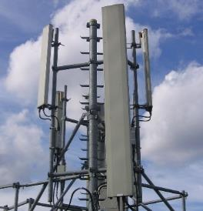

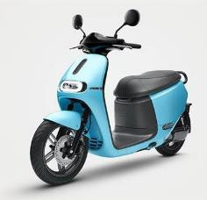
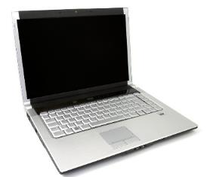
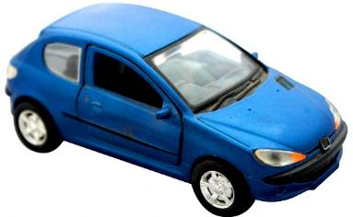
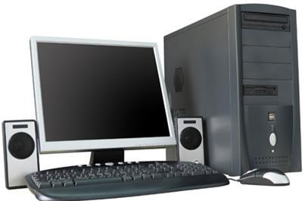
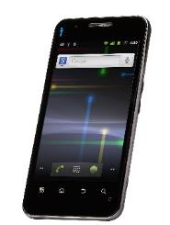
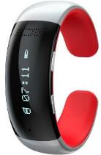
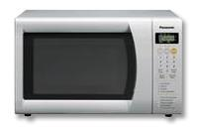
Computers Are Pervasive
We cannot live our daily life without them
You find computers everywhere

Slide 3
Surprisingly, Computers Are Similar Inside
Computer
Keyboard, Mouse
Processor
(active)
Memory
(passive)
(where
programs,
data live when
running)
Devices
Disk (where programs, data live when not running), Network
Control
(“brain”)
Input
Datapath
(“process”)
Output
Display, Speaker
Interconnection
Notes:
That is, any computer, no matter how primitive or advance, can be divided into five parts:
1. The input devices bring the data from the outside world into the computer.
2. These data are kept in the computer’s memory until ...
3. The datapath request and process them.
4. The operation of the datapath is controlled by the computer’s controller.
All the work done by the computer will NOT do us any good unless we can get the data back to the outside world.
5. Getting the data back to the outside world is the job of the output devices.
The most COMMON way to connect these 5 components together is to use a network of busses.

Slide 4
Outline
Why this course?
How does a computer work?
And, where does computer architecture stand?
Course outline
Course administration

Slide 5
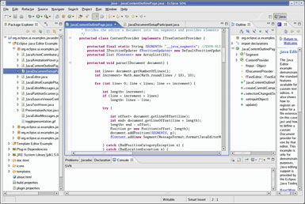
Let Us Start with a Program
We develop programs in high-level languages (HLL) through an integrated development environment (IDE)
HLL provides a level of abstraction closer to problem domain that is good for productivity and portability
Programs implement algorithms and often take input data, process them, produce output data
swap(int v[], int k) {
int temp;
temp = v[k];
v[k] = v[k+1];
v[k+1] = temp;
}

Slide 6
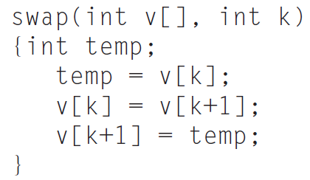
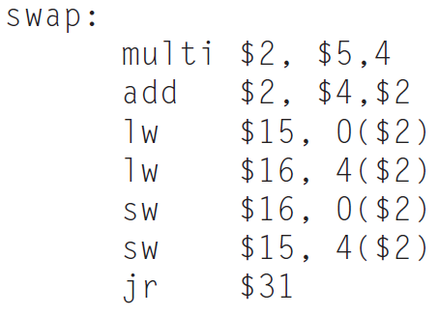
Program Translated to Machine Code
The HLL program must be translated into machine instructions to instruct computer processor how to execute (e.g. process input to produce output)
A compiler (called by IDE) translates a HLL program into an assembly language program
Textual representation of machine instructions
Compiler

Slide 7
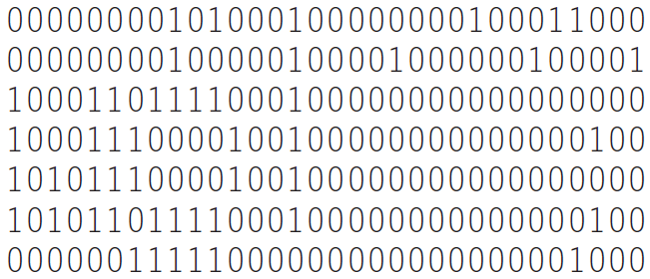
Program Translated to Machine Code
An assembler translates an assembly language program into machine executable code
An linker links separately compiled code modules and shared libraries into an executable program (file) containing encoded machine instructions and data, whereas the file is stored on the disk
Assembler

Slide 8
When the Program Is to Be Executed
Operating system uses a loader to load (part of) the binary executable program from disk into memory and prepare the executable code for running
Once loading is completed, operating system starts the program by passing CPU control to the loaded program code
Now computer hardware part starts to work to execute this program
Processor
Memory
Devices
Control
001101001011
001101001011
Datapath
Interconnection

Slide 9
Processor Executes the Machine Code
The computer processor fetches instructions from the program code in the memory and processes data in the memory as instructed
Control
Register
Datapath
0111
Control signals
Memory
0011
0100
Controller
ALU
001101001011
+
N
Z
clock
IR
PC
001101001011

Slide 10
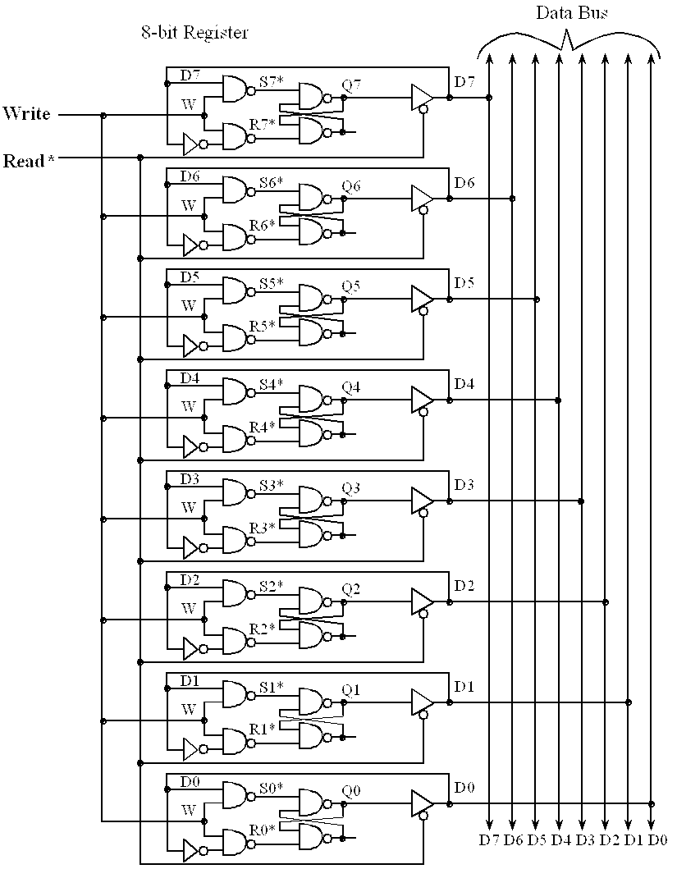
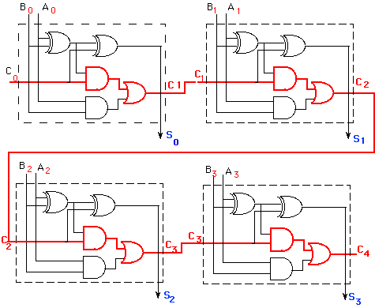
Inside the Processor
Components (registers, ALU) consist of logic gates via logic design
register
adder
http://gyan.fragnel.ac.in/~surve/COA/ISA/FixedPoint.html
http://users.ece.utexas.edu/~valvano/Volume1/E-Book/C4_DigitalLogic_files/image014.gif

Slide 11
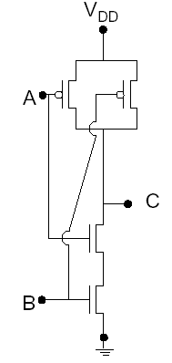
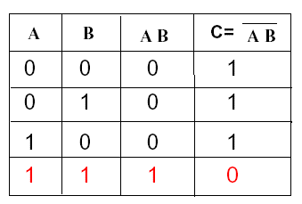
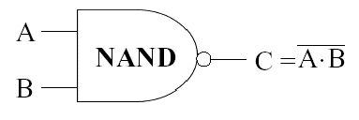
Logic Gate Can Be Made by Transistors
CMOS NAND:
Transistors are nothing but ON/OFF switches

Slide 12
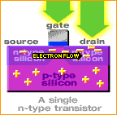
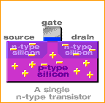
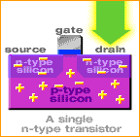
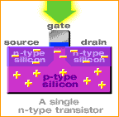
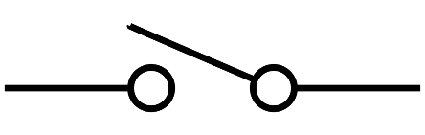
A Transistor to Switch ON/OFF
ON
OFF
This is a topic of electronic and circuit design

Slide 13
Where Computer Architecture Stand?
Computer architecture is not just computer hardware
Application
Operating System
Compiler
Software
Assembler
Hardware
Processor
Memory
I/O System
Datapath & Control
Digital Design
Instruction Set Architecture (ISA)
Circuit Design
Transistors

Slide 14
Instruction Set Architecture (ISA)
Instruction Set Architecture (or architecture in short)
An abstract interface between the hardware and the lowest-level software
Encompasses all the information necessary to write a machine language program that will run correctly, including instructions, registers, memory access, I/O, and so on
Why ISA important?
Enables many implementations of that architecture of varying cost and performance to run identical software, e.g. different x86 processors to run same Windows OS
Allows computer designers to design functions independently from the hardware that implements them

Slide 15
Example ISA
Intel 8051 (8-bit microcontroller) 1980-
TI MSP-430 (16-bit microcontroller) 1993-
Digital Alpha (v1, v3) 1992-2004
HP PA-RISC (v1.1, v2.0) 1986-2008
Sun Sparc (v8, v9) 1987-2017
MIPS (I ~ V, 32/64) 1985-
Intel x86 (8086,80286,80386, 1978- 80486,Pentium, MMX, SIMD, IA-64, ...)
ARM (v2~v7, v8) 1985-
RISC-V (v2.2) 2010-

Slide 16
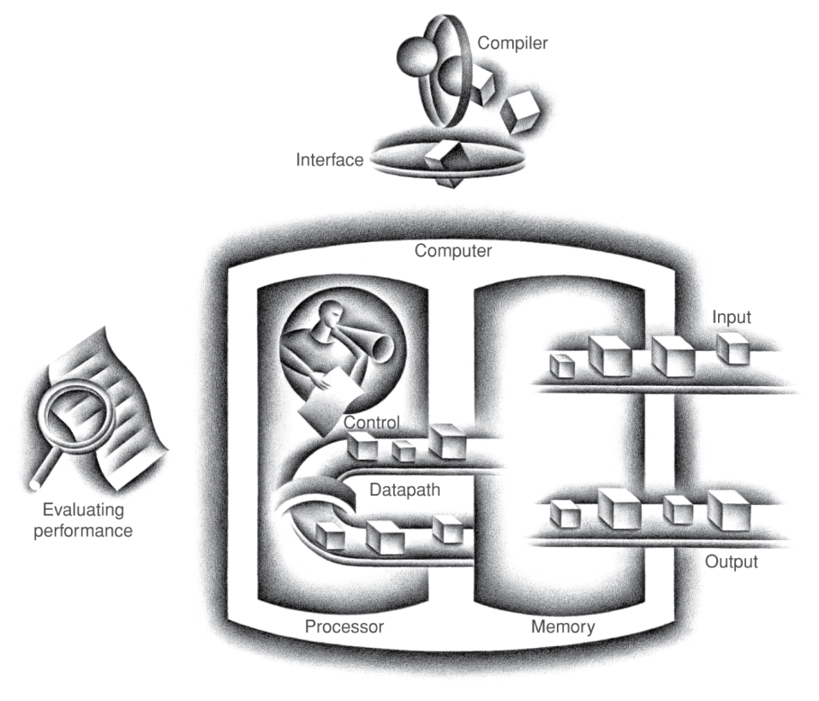
Computer Architecture Is Thus about …
SW/HW interface (ISA)
Computer organization
Quantitative design methodology (based on performance, power, cost, …)
ISA

Slide 17
Outline
Why this course?
How does a computer work?
And, where does computer architecture stand?
Course outline
Course administration

Slide 18
What You Will Learn
How programs are translated into the machine language
And how the hardware executes them
The hardware/software interface
What determines program performance
And how it can be improved
How computer hardware (processor, memory) works
How hardware designers improve performance
What is parallel processing

Slide 19
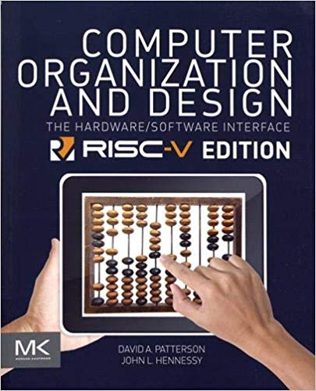
Textbook
Computer Organization and Design RISC-V Edition: The Hardware/Software Interface, 1st ed., David Patterson and John Hennessy, Morgan Kaufmann, Apr. 2017

Slide 20
Topics Covered
Topic Chapter
Computer Abstractions and Technology 1
Instructions: Language of the Computer 2
Arithmetic for Computers 3
The RISC-V Processor 4
Large and Fast: Exploiting Memory Hierarchy 5
Parallel Processors from Client to Cloud 6

Slide 21
Outline
Why this course?
How does a computer work?
And, where does computer architecture stand?
Course outline
Course administration

Slide 22
Course Administration: CS4100-01
授課老師: 金仲達
辦公室: 台達640
電話: 42804
email: king@cs.nthu.edu.tw
上課時間:
星期二10:10-12:00
星期四10:10-11:00
上課地點: 台達館105室
課程網頁:
iLSM
http://www.cs.nthu.edu.tw/~king/courses/cs4100.html

Slide 23
Prerequisites
Programming:
Any programming language (C or C++ preferred)
Logic design:
Logic equations, schematic diagrams, finite state machine

Slide 24
Expected Course Workload
Learn processor emulators and benchmarking
4~7 homework assignments
Assignments are a mixture of design, calculation, programming, measurement, and discussion problems
Assignments will be posted on iLMS
Independent of, but complement, examinations
One mid-term and one final examination
Grade breakdown (may adjust final grades)
Homework assignments 50%
Class participation and quiz 10%
Midterm exam 20%
Final exam 20%
Can bring 1-page note of A4 size

Slide 25
Resources on the Internet
Course website of Prof. Tingting Hwang
http://www.cs.nthu.edu.tw/~tingting/cs4100.html
Open Course Ware (OCW)
http://ocw.nthu.edu.tw/ocw/index.php?page=course&cid=76&
ShareCourse
http://www.sharecourse.net/sharecourse/course/view/courseInfo/26
MOOCs
http://mooc.nthu.edu.tw/sharecourse/course/view/courseInfo/112 <-- need to register for the course first
Online resources of textbook:
https://www.elsevier.com/books-and-journals/book-companion/9780128122754

Slide 26
Course Problems
Cannot turn in homework on time
No late homework is accepted
Forgot to turn in homework/Dog ate computer
???
What is cheating?
Study together in groups is encouraged
Work must be your own

Slide 27
Course Schedule
No class on the following days:
3/26 (Tue.): 2 hr
3/28 (Thu.): 1 hr
4/18 (Thu.): 1 hr
Makeup plan: class on selected Thursdays 11:00-12:00
3/7
3/14
3/21
4/11

